Slide 1
Services and Services System Service-Oriented Software Engineering
Software Institute
Nanjing University
Bei Jia

Slide 2
What is service
James Fitzimmons, Service management
A service is a time-perishable, intangible experience performed for a customer acting in the role of co-producer
Christian Gronroos, Service Management and Marketing: A Customer Relationship Management Approach
A service is an activity or series of activities of more or less intangible nature that normally, but not necessarily, take place in interactions between customer and service employees and/or physical resources or goods and/or systems of the service provider, which are provided as solutions to customer problems

Slide 3
Services examples
Traditional transportation and warehousing
Information
Finance, stock market
Rental and leasing
Scientific and technical services
Administration
Entertainments
……

Slide 4
Service vs. Manufacturing Model (1/2)
Outputs: Services vs. Goods

Slide 5
Service vs. Manufacturing Model (2/2)
A precise definition of goods and services should distinguish them on the basis of their attributes.
A good is a tangible physical object or product that can be created and transferred; it has an existence over time and thus can be created and used later.
A service is intangible and perishable. It is an occurrence or process that is created and used simultaneously or nearly simultaneously. While the consumer cannot retain the actual service after it is produced, the effort of service can be retained.

Slide 6
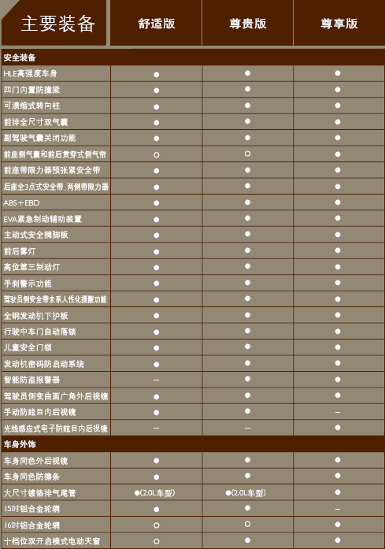
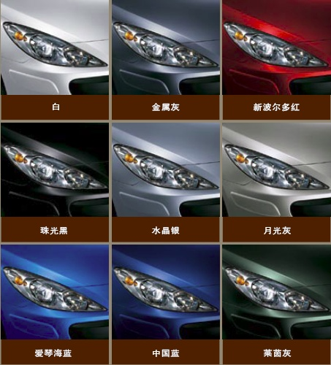
Integration of Manufacturing and service (1/3)

Slide 7
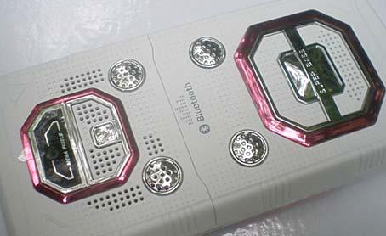
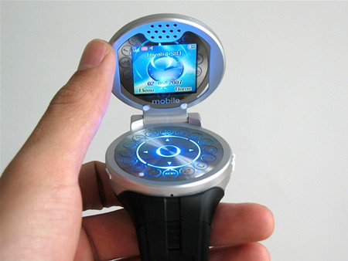
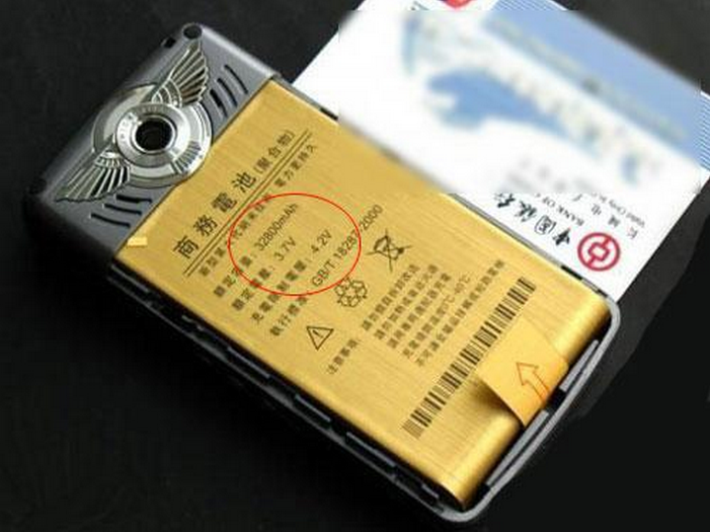
Integration of Manufacturing and service (2/3)

Slide 8
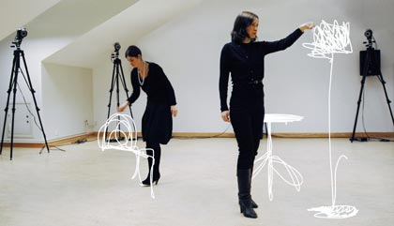
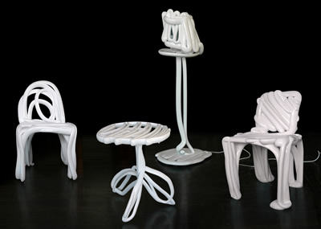
Integration of Manufacturing and service (3/3)

Slide 9
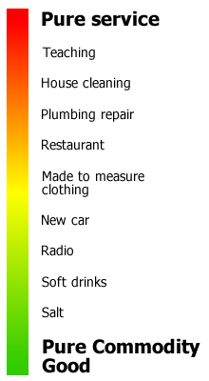
Service-goods continuum

Slide 10
Trend (1/2)
Pure Manufacturing decreases
Service industry arises
Property service
Security ensuring
Gardening
Cleaning work
Maintaining and fixing
……
Software developing (Outsourcing model) included

Slide 11
Trend (2/2)
Services are becoming more and more complex
Call in center of bank (with support system)
Hospital which offers medical services (with HIS)
Complex enterprise management (with ERP, CRM and so on…)
e-bank or e-commerce (B2C, B2B)
……
IT system is introduced
With or without service employees

Slide 12
Services System
IT software system that realizes business services
A considerable number of software systems are services systems
Informally defined as 6-tuples
Inputs
Outputs
Goals (Internal/External)
Transformation
Components
Sensors

Slide 13
Components
Service people
Designer
Developer
Tester and so on
Service partners
Customers if needed
Service employee if needed
Service Information
Service activates
Service infrastructure resources (Physical/IT/Abstract)

Slide 14
Self Contained & Encapsulated

Slide 15
Perspectives of service systems (1/2)
Model
Service Operation Model
Service Delivery Model
Service Capacity Model
Technology
Traditional Software Technology and Method
Web Services/SOA
Grid
Autonomic Computing

Slide 16
Perspectives of service systems (2/2)
Architecture
Data architecture
Application architecture
Performance architecture
Optimization
Operational research
Complex system
System engineering

Slide 17
Problems in Services System
The complexity of services system
The flexibility of services system
Specialization and outsourcing model
The evolvement of computing environment
The gap between IT specialists and business specialists
New values added and innovative functions
Series of services systems with slightly difference (product families, product line)

Slide 18
IT-enabled business service
When business service is provided with services systems, it is IT-enabled
Services represent a type of relationships-based interactions (activities) between at least one service provider and one service consumer to achieve a certain business goal or solution objective
Operation model
Charge model

Slide 19
2 features of IT-enabled Service
Service operation models
End to end model
Hosted service model
Business process outsourcing
Data-centered outsourcing
Service through online broker agency
Service charge models (can be multi-leveled)
Free-of charge model
Fee-based model
Government service model

Slide 20
IT and Non-IT Services
Common features
The same principle of a services lifecycle
The same set of elements of a services system
Major difference
Key performance indicators (KPIs)
Requirements managements
The paces of changes

Slide 21
Services Ecosystem
From the view of consumers
There are many services can be utilized simultaneously and independently
So they are called vertical services
Divided into pure IT services and IT-enabled services
Vertical services can be constructed with some reusable cross-industry common services
So they are called horizontal services
Divided into common business services and IT services

Slide 22
Overview of a services ecosystem

Slide 23
Service inventory
A service inventory is an independently standardized and governed collection of complementary services within a boundary that represents an enterprise or a meaningful segment of an enterprise
The inventory can be structured into layers according to the service models used
application service layer
business service layer (task-centric or entity-centric)
orchestration service layer
Before built, the service inventory blueprint is given

Slide 24
The Question is …
How to leverage limited resources to build and maintain proper services systems?
That is…. how to build and maintain a proper services ecosystem/Service inventory?

Slide 25
Read more…
题名/责任者:Services computing = 服务计算 / Liang-Jie Zhang, Jia Zhang, Hong Cai.
出版发行项:Beijing : Tsinghua University Press ; Berlin ; New York : Springer, c2007.
ISBN:9787302150756 (Tsinghua University Press)
ISBN:9783540382812 (Springer)
URL:http://202.119.47.8:8080/opac/item.php?marc_no=0003334218

